Slide 1
Computer Architecture Experiment
Topic 2. Pipelined CPU supporting
exception & interrupt
浙江大学计算机学院
2021年9月

Slide 2
Outline
Experiment Purpose
Experiment Task
Basic Principle
Operating Procedures
Checkpoints

Slide 3
Experiment Purpose
Understand the principle of CPU exception & interrupt and its processing procedure.
Master the design methods of pipelined CPU supporting exception & interrupt.
master methods of program verification of Pipelined CPU supporting exception & interrupt.

Slide 4
Experiment Task
Design of Pipelined CPU supporting exception & interrupt.
Design datapath
Design Co-processor & Controller
Verify the Pipelined CPU with program and observe the execution of program

Slide 5
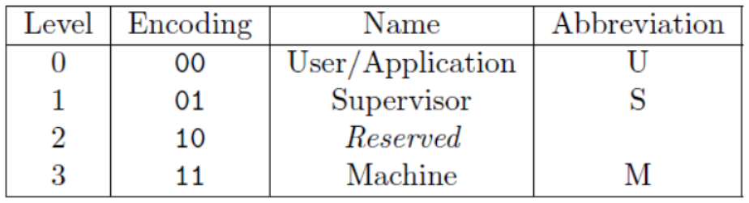
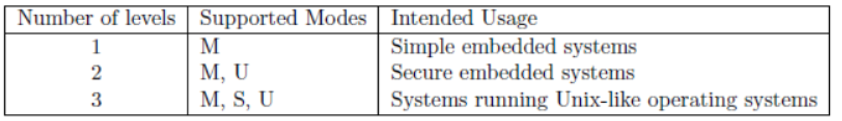
Pipelined CPU supporting exception & interrupt

Slide 6
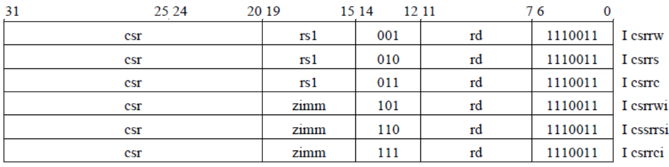
Pipelined CPU supporting exception & interrupt

Slide 7
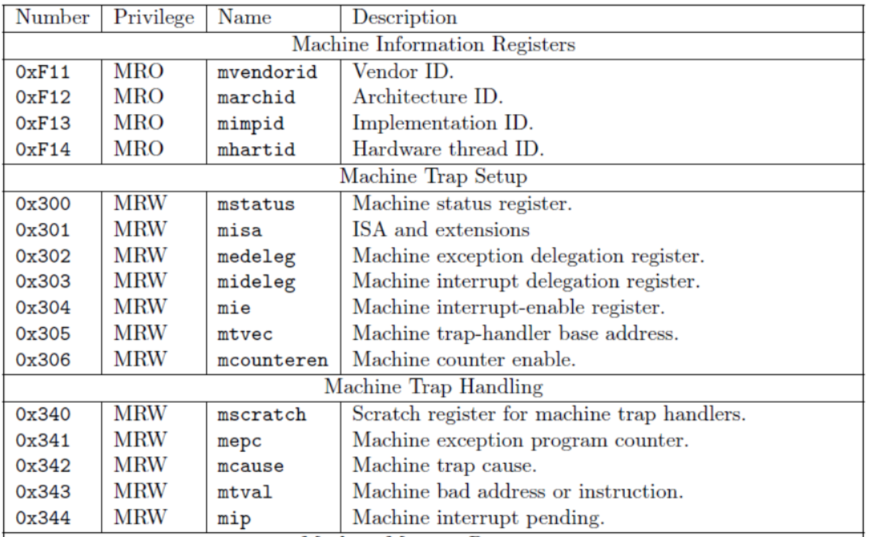
Pipelined CPU supporting exception & interrupt

Slide 8
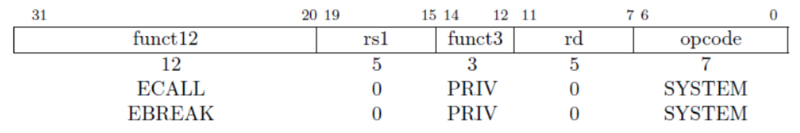
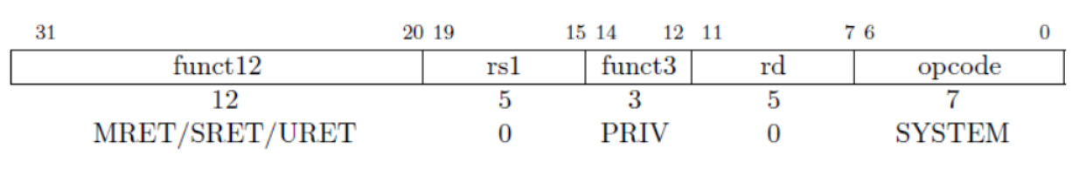
Pipelined CPU supporting exception & interrupt
Environment Call and Breakpoint
Trap-Return Instructions

Slide 9
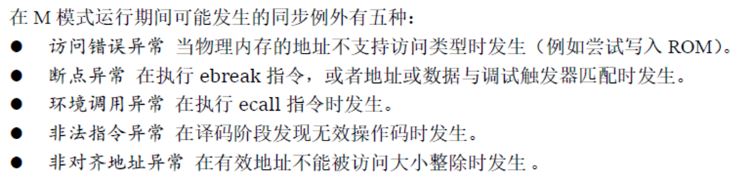
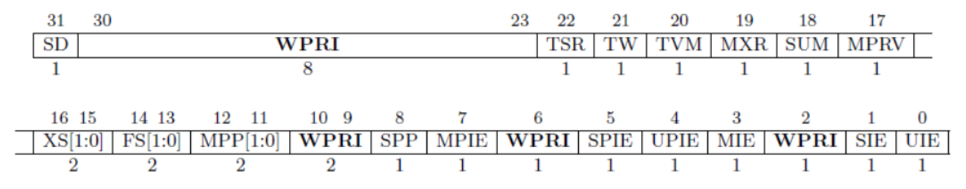
Pipelined CPU supporting exception & interrupt
Machine-mode status register (mstatus) for RV32.
Notes:
非法指令
ECALL
L/S 地址超范围

Slide 10
Pipelined CPU supporting exception & interrupt
发生异常/中断时，硬件自动经历如下的状态转换：
⚫ 异常指令的PC被保存在mepc中，PC被设置为mtvec。mepc指向导致异常的指令；对于中断，它指向中断处理后应该恢复执行的位置。
⚫ 根据异常来源设置mcause，并将mtval设置为出错的地址或者其它适用于特定异常的信息字。
⚫ 把控制状态寄存器mstatus中的MIE位置零以禁用中断，并把先前的MIE值保留到MPIE中。
⚫ 发生异常之前的权限模式保留在mstatus的MPP域中，再把权限模式更改为M。
Notes:
非法指令
ECALL
L/S 地址超范围

Slide 11
Pipelined CPU supporting exception & interrupt

Slide 12
Instr. Mem.(1)
NO. | Instruction | Addr. | Label | ASM | Comment
0 | 00000013 | 0 | __start: | addi x0, x0, 0
1 | 00402103 | 4 |  | lw x2, 4(x0)
2 | 00802203 | 8 |  | lw x4, 8(x0)
3 | 00c02283 | C |  | lw x5, 12(x0)
4 | 01002303 | 10 |  | lw x6, 16(x0)
5 | 01402383 | 14 |  | lw x7, 20(x0)
6 | 306850f3 | 18 |  | csrrwi x1, 0x306, 16
7 | 306020f3 | 1C |  | csrr x1, 0x306
8 | 306310f3 | 20 |  | csrrw x1, 0x306, x6
9 | 306020f3 | 24 |  | csrr x1, 0x306
10 | 00000013 | 28 |  | addi x0, x0, 0
11 | 07800093 | 2C |  | addi x1, x0, 120
12 | 30509073 | 30 |  | csrw 0x305, x1
13 | 00000013 | 34 |  | addi x0, x0, 0
14 | 00000073 | 38 |  | ecall

Slide 13
Instr. Mem.(2)
NO. | Instruction | Addr. | Label | ASM | Comment
15 | 00000013 | 3C |  | addi x0, x0, 0
16 | 00000012 | 40 |  | addi x0, x0, 0 | # change to illegal
17 | 00000013 | 44 |  | addi x0, x0, 0
18 | 07f02083 | 48 |  | lw x1, 127(x0)
19 | 08002083 | 4C |  | lw x1, 128(x0) | # l access fault
20 | 00000013 | 50 |  | addi x0, x0, 0
21 | 08102023 | 54 |  | sw x1, 128(x0) | # s access fault
22 | 00000013 | 58 |  | addi x0, x0, 0
23 | 00000013 | 5C |  | addi x0, x0, 0
24 | 00000013 | 60 |  | addi x0, x0, 0
25 | 00000013 | 64 |  | addi x0, x0, 0
26 | 00000013 | 68 |  | addi x0, x0, 0
27 | 00000013 | 6C |  | addi x0, x0, 0
28 | 00000013 | 70 |  | addi x0, x0, 0
29 | 00000067 | 74 |  | jr x0

Slide 14
Instr. Mem.(3)
NO. | Instruction | Addr. | Label | ASM | Comment
30 | 34102cf3 | 78 | trap: | csrr x25, 0x341 | # mepc
31 | 34202df3 | 7C |  | csrr x27, 0x342 | # mcause
32 | 30002e73 | 80 |  | csrr x28, 0x300 | # mstatus
33 | 30402ef3 | 84 |  | csrr x29, 0x304 | # mie
34 | 34402f73 | 88 |  | csrr x30, 0x344 | # mip
35 | 004c8113 | 8C |  | addi x2, x25, 4
36 | 34111073 | 90 |  | csrw 0x341, x2
37 | 30200073 | 94 |  | mret | # 30200073 mret
38 | 00000013 | 98 |  | addi x0, x0, 0
39 | 00000013 | 9C |  | addi x0, x0, 0
40 | 00000013 | A0 |  | addi x0, x0, 0
41 | 00000013 | A4 |  | addi x0, x0, 0

Slide 15
Data Mem.
NO. | Data | Addr. | Comment
0 | 000080BF | 0
1 | 00000008 | 4
2 | 00000010 | 8
3 | 00000014 | C
4 | FFFF0000 | 10
5 | 0FFF0000 | 14
6 | FF000F0F | 18
7 | F0F0F0F0 | 1C
8 | 00000000 | 20
9 | 00000000 | 24
10 | 00000000 | 28
11 | 00000000 | 2C
12 | 00000000 | 30
13 | 00000000 | 34
14 | 00000000 | 38
15 | 00000000 | 3C
NO. | Instruction | Addr. | Comment
16 | 00000000 | 40
17 | 00000000 | 44
18 | 00000000 | 48
19 | 00000000 | 4C
20 | A3000000 | 50
21 | 27000000 | 54
22 | 79000000 | 58
23 | 15100000 | 5C
24 | 00000000 | 60
25 | 00000000 | 64
26 | 00000000 | 68
27 | 00000000 | 6C
28 | 00000000 | 70
29 | 00000000 | 74
30 | 00000000 | 78
31 | 00000000 | 7C

Slide 16
Test Bench
RV32core core(
.debug_en(1'b0),
.debug_step(1'b0),
.debug_addr(7'b0),
.debug_data(),
.clk(clk),
.rst(rst),
.interrupter(1'b0)
);
initial begin
clk = 0;
rst = 1;
#2 rst = 0;
end
always #1 clk = ~clk;

Slide 17
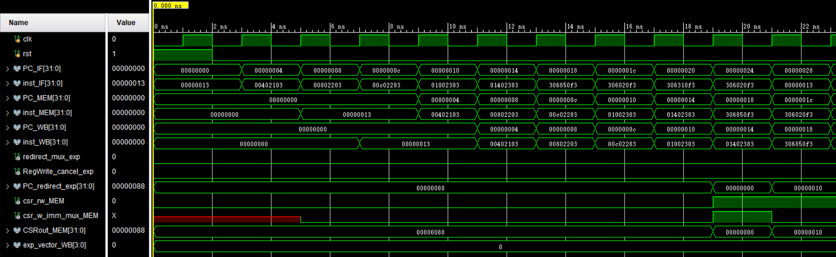
Simulation (1)

Slide 18
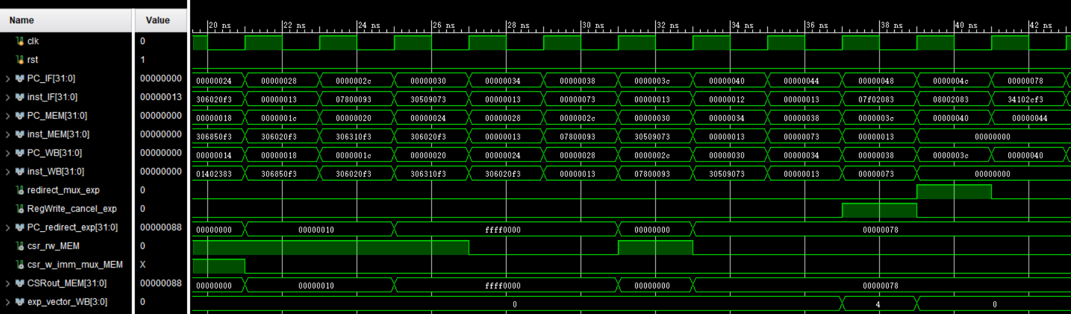
Simulation (2)

Slide 19
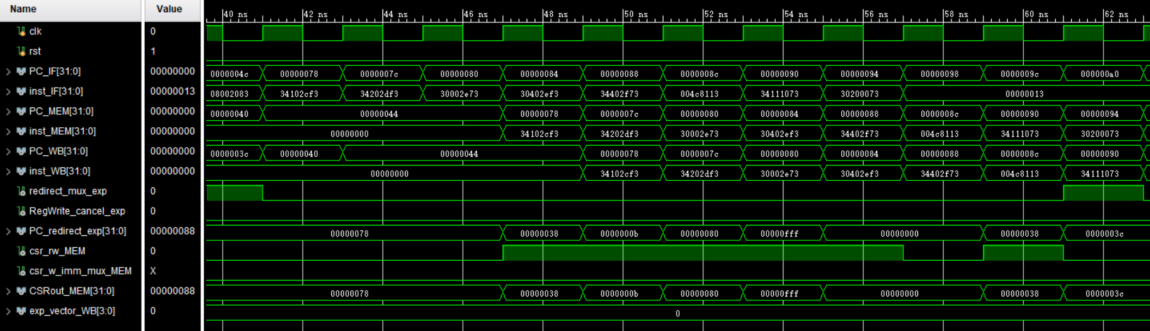
Simulation (3)

Slide 20
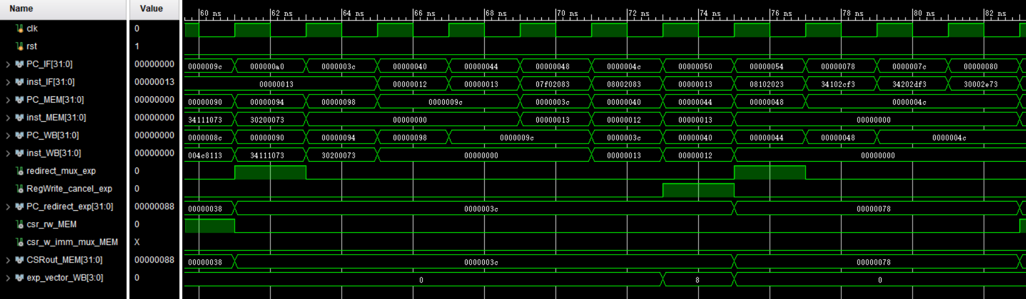
Simulation (4)

Slide 21
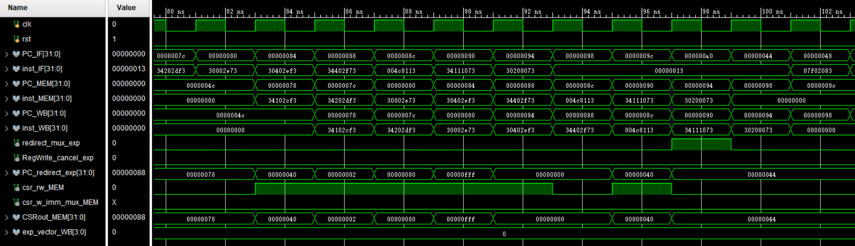
Simulation (5)

Slide 22
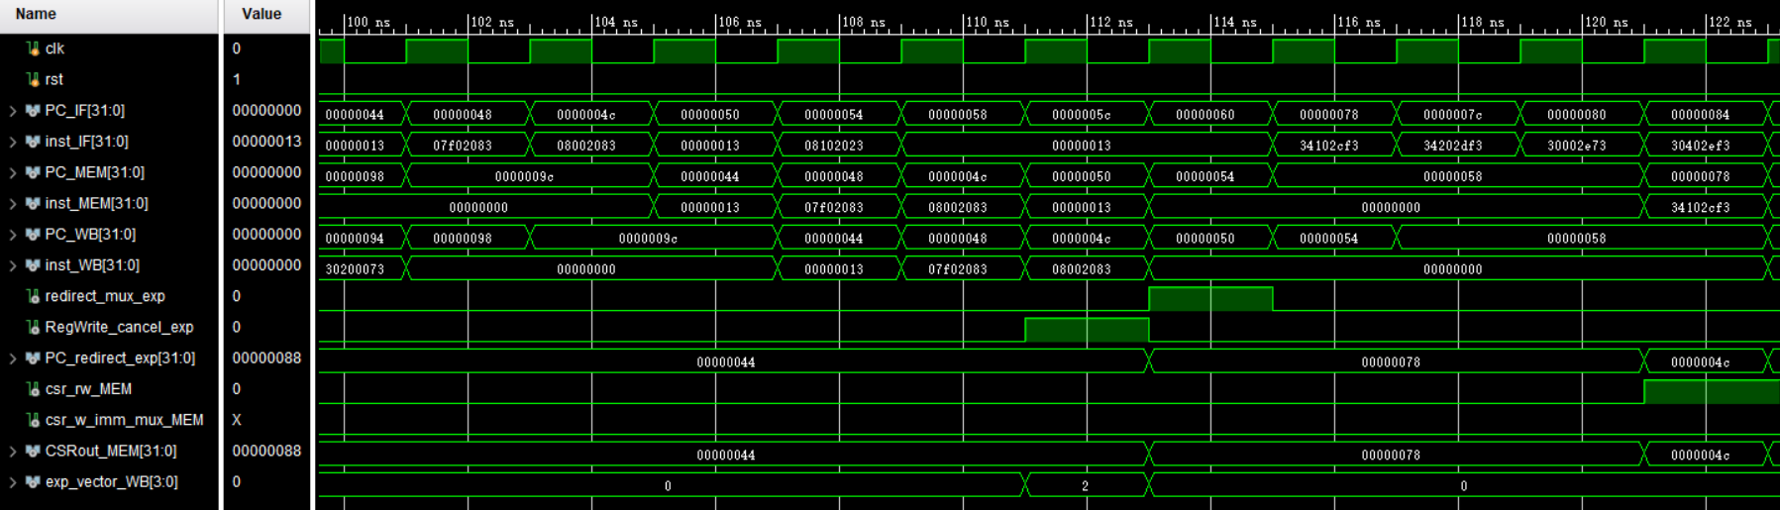
Simulation (6)

Slide 23
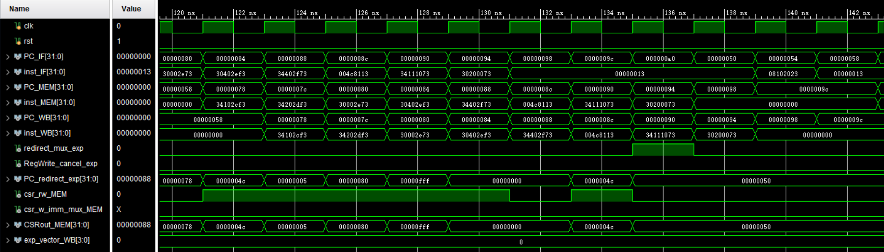
Simulation (7)

Slide 24
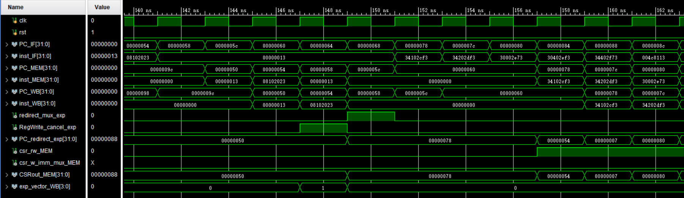
Simulation (8)

Slide 25
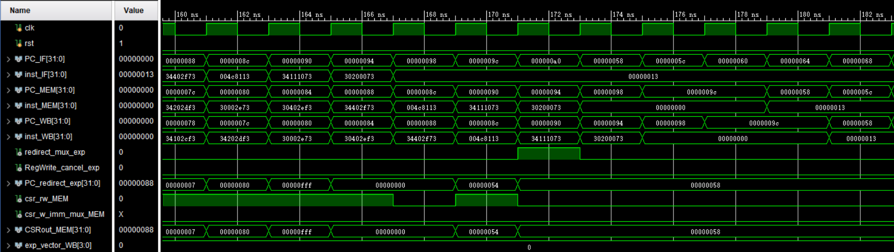
Simulation (9)

Slide 26
Checkpoints
CP 1:
Waveform Simulation of the Pipelined CPU with the verification program
CP 2:
FPGA Implementation of the Pipelined CPU with the verification program

Slide 27
Thanks!

